Slide 1

Improvements to the Kigen Solver
Jordan Taylor 313D

Slide 2
Overview
Introduction
Background
Research Questions
Methods and Experiments
Conclusions
Future Work

Slide 3

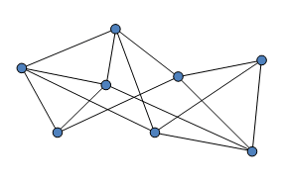
About Me
Rising 3rd year at Georgia Tech
Studying Computer Science and Math
Research Interests:
Decision Theory
Reinforcement Learning
Optimization
Approximation Algorithms
Meta-Learning

Slide 4
What is Kigen?
Design Space Exploration and Optimization Tool
Engineer defined trade space, objectives and constraints
Kigen
Set of Pareto Efficient Designs
Input
Output
Notes:
5

Slide 5
The Kigen Modeling Language (KigenML)
Design Problem Definition in KigenML
/* Domain description */ type ConstellationMission { var spacecraft : Spacecraft [ 2 .. 50 ] fun cost = { …// Some complex function fun benefit = { … // Another function constraint atLeast2SC: filter( spacecraft, (s : Spacecraft) => s.payload != null ).size > 1) } type Spacecraft { var payload : Payload [ 0 .. 1 ] } abstract type Payload type InterferometryPayload extends Payload
/* Initial conditions */ model myMission of ConstellationMission { model sc1 of Spacecraft in spacecraft model sc2 of Spacecraft in spacecraft { model p1 of InterferometryPayload in payload } } /* Define optimization criteria */ minimize myMission.cost maximize myMission.benefit solve optimize using 'nsgaii' 30 times with populationSize 100, maxGenerations 20, maxSolutionLength 15
Able to derive domain model and reason about how to explore the space
Notes:
Spend 2 minutes here
Think of a mathematical programming language
Extension to include structures
Mix of quadratic programming language, a bit of general purpose language, and flavors of model finders: e.g., MIT’s Alloy, and Microsoft FORMULA (TODO: Find a good definition for these)
model finding tools and satisfiability checkers

Slide 6
Kigen Explained
Crossover
Rule “addSpacecraft”
Trade Space is
Represented
Designs are
Analyzed
User
Add Spacecraft
Add X-Band Comm
Add Spacecraft
Add Comm Link
m : Mission
m : Mission
NEW
sc
Add Spacecraft
Add Ka-Band Comm
Add Payload
Add Spacecraft
sc : S/C
NEW
Kigen
Compiled to
EMF
Initial Model is
Created to
Search from
Transformation
Rules are Created
Trade Space
is Searched
Left hand side (Condition)
Right hand side (Operation)
Add Ka-Band Comm
Solution Representation
Add Spacecraft
Add X-Band Comm
Add Spacecraft
Add Comm Link
Mutation

Slide 7
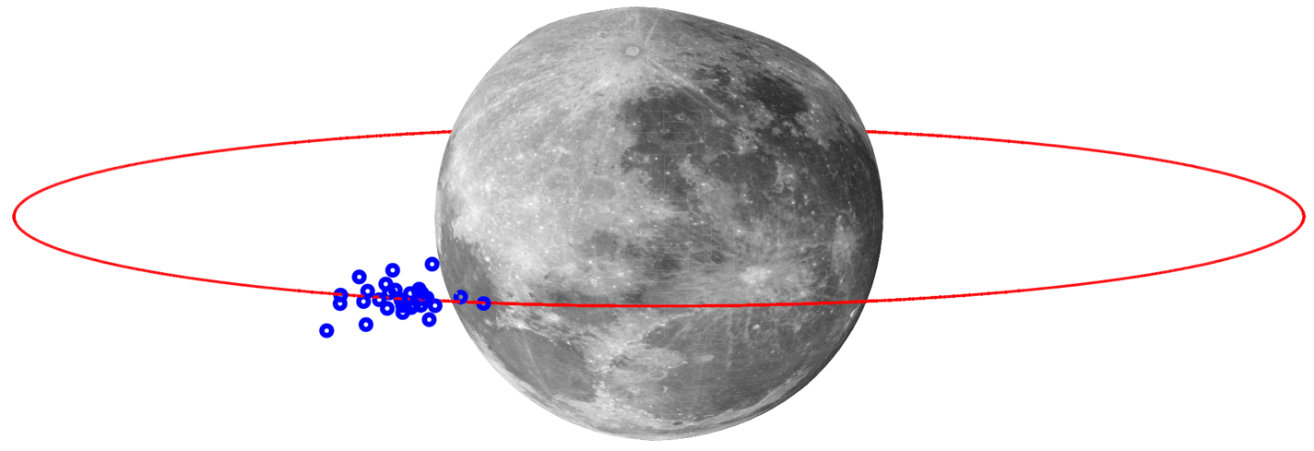
Background
Motivating Case Study: Spacecraft-Based Radio Interferometry
Radio interferometers:
Radio telescopes consisting of multiple antennas
Achieve the same angular resolution as that of a single telescope with the same aperture
➔ Typically ground-based
Source: http://www.passmyexams.co.uk/GCSE/physics/images/radio-telescopes-outdoors.jpg
Want to do this in space:
Frequencies < 30Mhz blocked by ionosphere
Cluster of spacecraft (3 – 50) functioning as telescopes in LLO
➔ CubeSats or SmallSats are promising enablers for this
Notes:
17
that receive radio waves from the same astronomical object
Interesting to observe, e.g., galaxies
Narrowed down to cluster of spacecraft acting as antennas in lower lunar orbit; all small spacecraft under 100 kilogram
Transition: when first looking at the problem, seems fairly simple

Slide 8
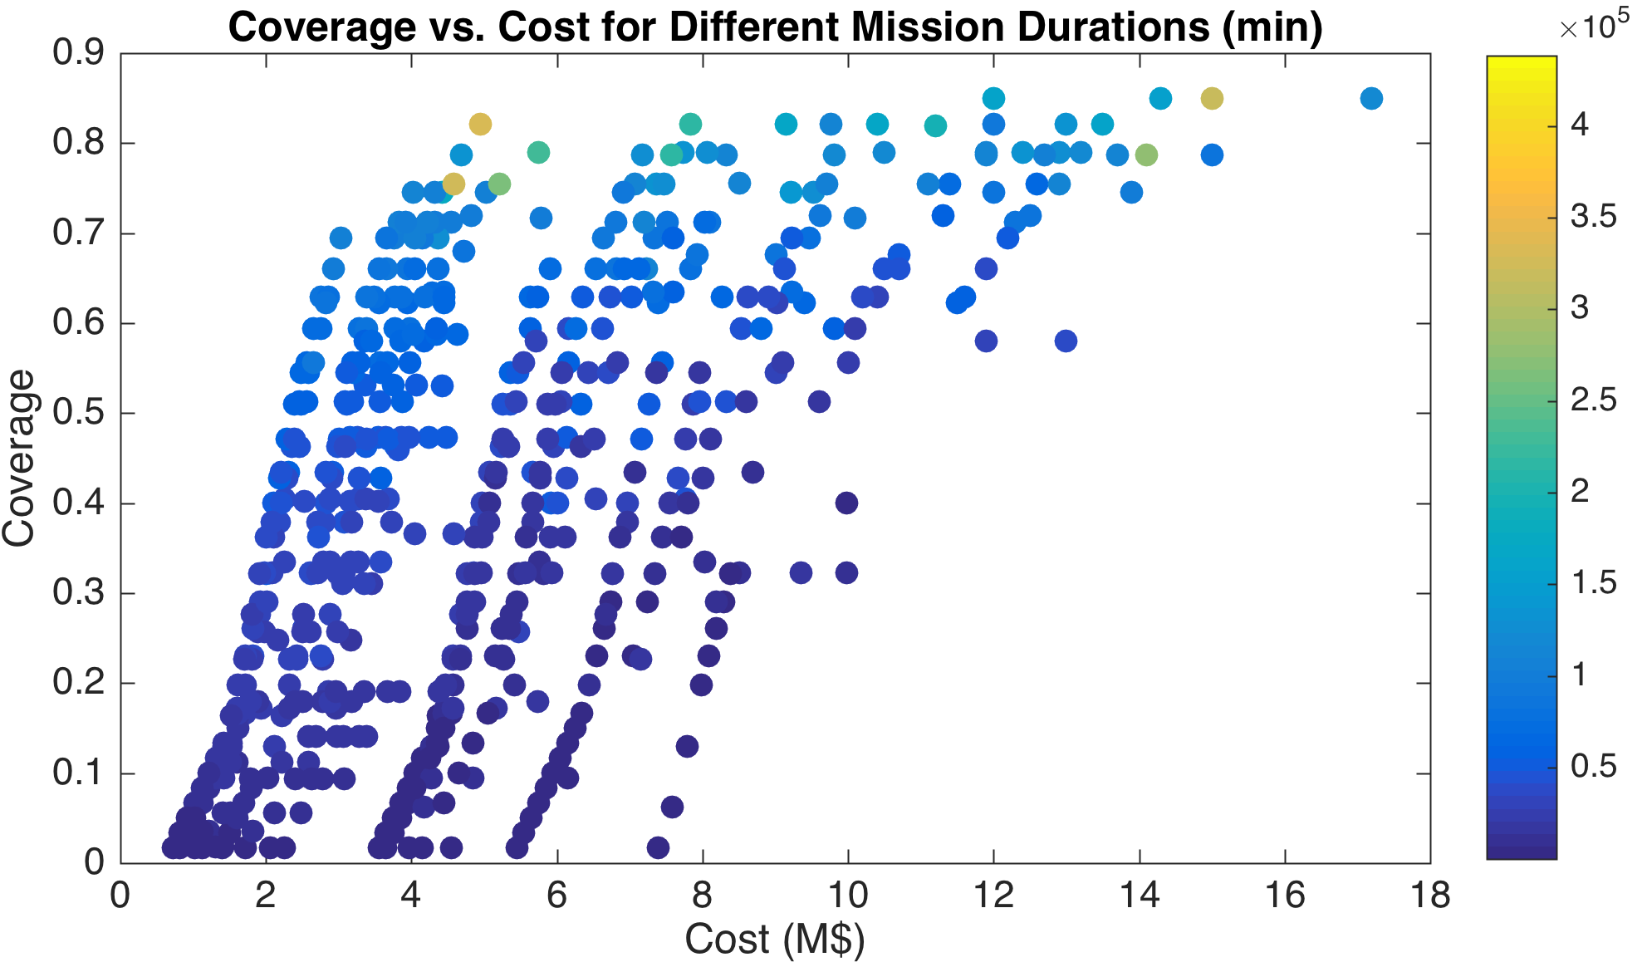
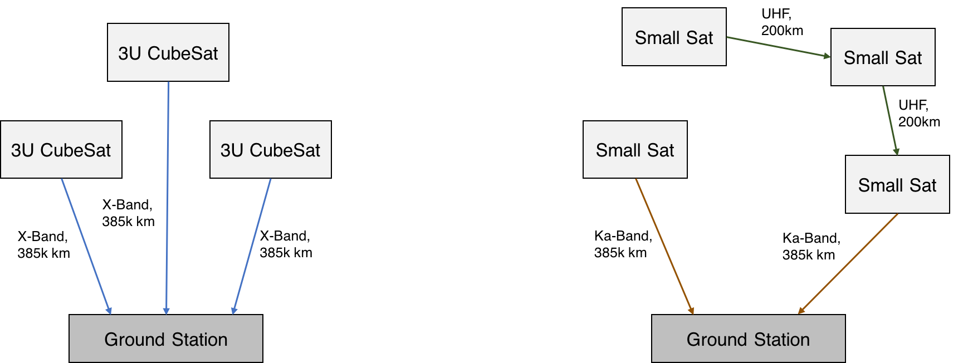
Background
Results from Multi-Spacecraft Interferometry Mission

Slide 9
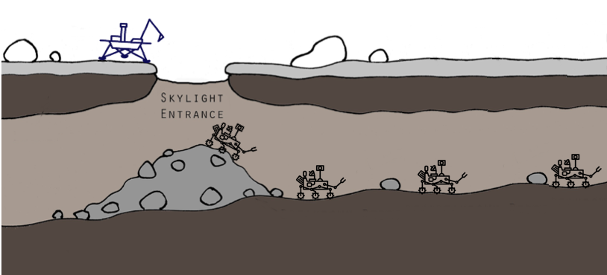
Background
Motivating Case Study: Multi-Rover Mars Cave Exploration
Why Explore Caves on Mars?
Possibility for human settlement
Understanding the planet’s evolution
Search for Extraterrestrial Life
Why use Multiple Rovers?
To Improve Fault Tolerance
To perform science deeper in the caves
Notes:
17
that receive radio waves from the same astronomical object
Interesting to observe, e.g., galaxies
Narrowed down to cluster of spacecraft acting as antennas in lower lunar orbit; all small spacecraft under 100 kilogram
Transition: when first looking at the problem, seems fairly simple

Slide 10


Research Questions
Want to Improve
It can take a long time to find a feasible solution
Will starting the search from a small model that satisfies some requirements decrease the time needed to find a feasible solution?
Autonomously generated exploration rules underperform those created by domain experts, increasing the workload of users and the number of iterations needed to find quality solutions
Can autonomously generated rules perform comparably to those created by domain experts, making Kigen easier to use?
Almost all research in the field of model-based design has used a genetic algorithms to find solutions
Can other algorithms search the model-space better than a genetic algorithm?
Runtime
Quality

Slide 11
Research Questions
Will starting the search from a small, feasible model decrease the time needed to find a solution?
Can autonomously generated rules outperform those created by domain experts?
Can other algorithms search the model-space better than a genetic algorithm?

Slide 12
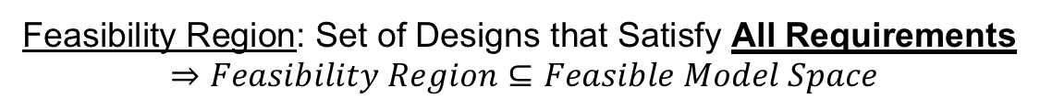
Improving Starting Location of Search
Methodology
Feasible Model Space: Set of Designs that Satisfy All Multiplicity Requirements
Feasibility Region: Set of Designs that Satisfy All Requirements
$$⇒Feasibility Region⊆Feasible Model Space$$
Example Requirement: A mission must have between 2 and 10 rovers
Proposed Method
Start searching from the smallest feasible model using what is specified by the user
Current Method
Start searching from an empty model unless otherwise specified by the user
Feasible Model
Space
In Feasible Model
Space
Not in Feasible
Model Space
Feasibility
Region
Mission
Mission
Rover
Rover
Rover

Slide 13
Improving Starting Location of Search
Application to Case Study: Multi-Rover Mars Cave Exploration Mission
Subset of Requirements
A RoverConstellation must have between 2 and 10 Rovers
A RoverConstellation must have a BaseStation
A Rover must have a Camera and an EnvironmentSensor
Current Starting Model
(Without Any User Guidance)
Proposed Starting Model
(Without Any User Guidance)
RoverConstellation
RoverConstellation
Rover
BaseStation
Rover
Camera
EnvSensor
Camera
EnvSensor

Slide 14

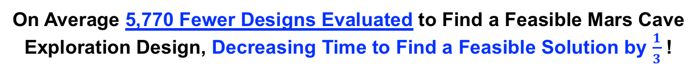
Improving Starting Location of Search
Experimental Results
On Average 5,770 Fewer Designs Evaluated to Find a Feasible Mars Cave
Exploration Design, Decreasing Time to Find a Feasible Solution by $\frac{1}{3}$ !

Slide 15
Research Questions
Will starting the search from a small, feasible model decrease the time needed to find a solution?
Can autonomously generated rules outperform those created by domain experts?
Can other algorithms search the model-space better than a genetic algorithm?

Slide 16
New Exploration Rules: Method
Current: Small Atomic Rules
Proposed: Rules Made by Combining Multiplicity Requirements
A Mission
contains
2 to 5 rovers
A Rover
contains 1 to 3
Instruments
A Mission contains 2 to 5 rovers AND a Rover contains 1 to 3 Instruments
addMissionRule
+
addRoverRule
=
Mission
Rover
Mission
Rover
Rover
Instrument
Rover
Rover
Instrument
Instrument

Slide 17
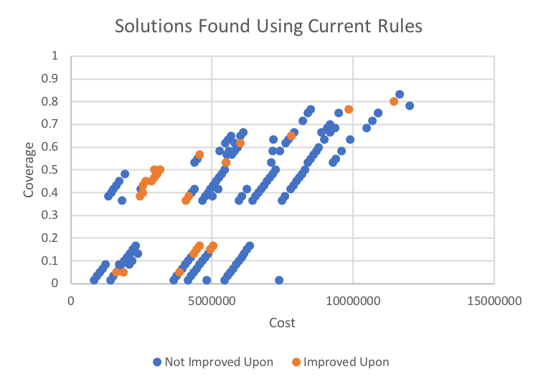
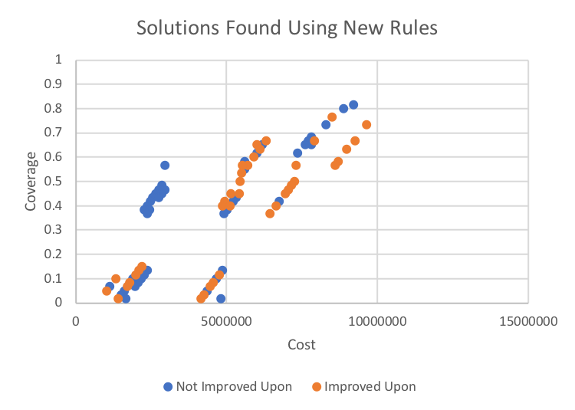
New Exploration Rules: Results
Current vs New Rule Comparison: Interferometry Mission Design
Experiment Setup:
Ran a genetic algorithm 5 times with a solution length of 150, population size of 1000 and 100 generations using the current rules then the new rules
New rules did not increase solution quality
Solutions found using Current Rules
Solutions found using New Rules

Slide 18
New Exploration Rules: Results
Why did the Current Rules Outperform the New Rules?
For an equal solution length, the new exploration
rules’ search space is limited to larger models
Feasible Model Space
New Proposal: Use BOTH the current and more complex rules to better search the entire model space
# 3U
CubeSats
For an equal solution length, the current exploration
rules’ search space is limited to smaller models
#
SmallSats
0
# 6U CubeSats

Slide 19
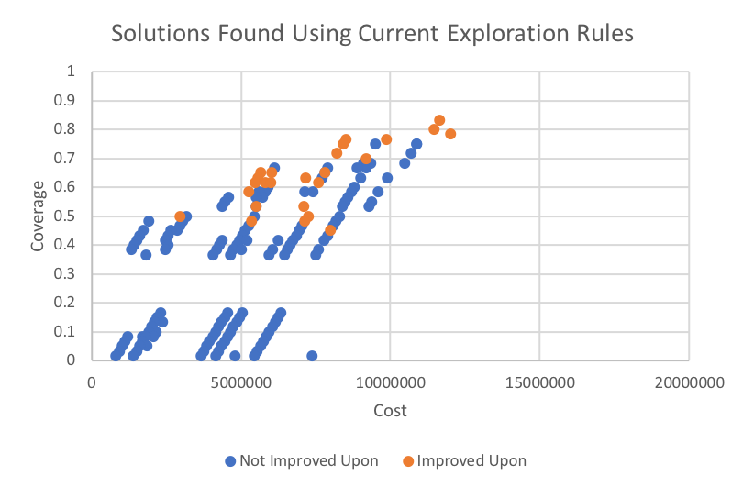
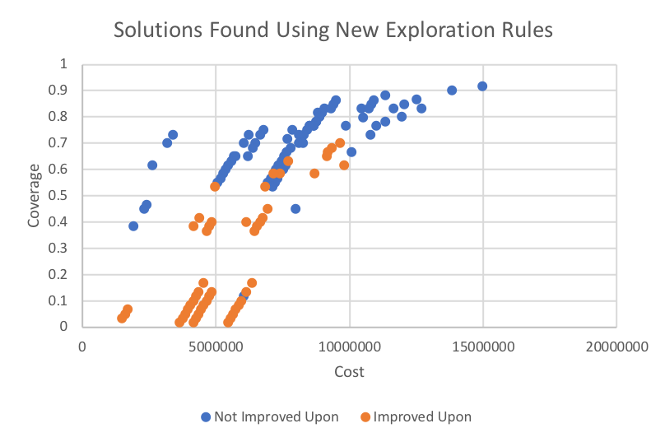
New Exploration Rules: Results
Current vs New Rule Comparison on the Interferometry Mission
Solutions Found Using Current Rules
Solutions Found Using New Rules
(Both Simple and Complex)
Current Rules Better Searched Region Corresponding to Smaller Models because only a Small Portion of the Feasible Model Space is Reachable
New Rules Better Searched the Whole Design Space because more of the Feasible Model Space can be Reached
= Worse w.r.t Solutions Found in the Experiment Being Compared with

Slide 20
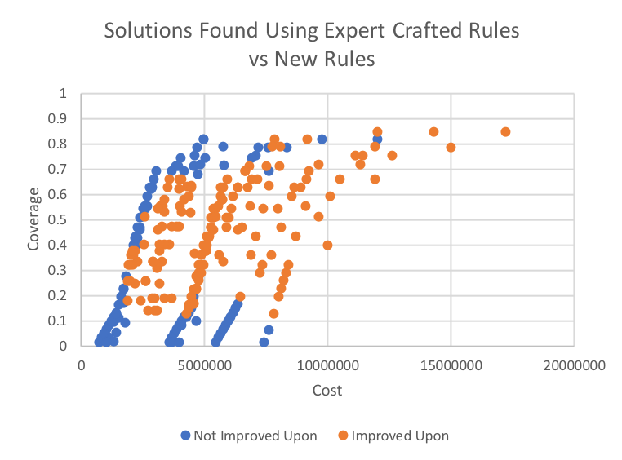
New Exploration Rules: Results
Expert Crafted Rules vs New Rules on the Interferometry Mission
Experiment Setup:
Ran a genetic algorithm 5 times with a solution length of 150, population size of 1000 and 100 generations using the new rules
Same population size and generations used to find the expert rule solutions
With all else equal, of the designs found by expert crafted rules, 63% were improved upon by designs found using new, autonomously generated rules!

Slide 21
Research Questions
Will starting the search from a small, feasible model decrease the time needed to find a solution?
Can autonomously generated rules outperform those created by domain experts?
Can other algorithms search the model-space better than a genetic algorithm?

Slide 22
New Algorithm: Genetic Algorithm Problems
The Crossover Operation
Two High Performing Solutions
Crossover
Problem: Models are
Highly Coupled
Add Electric Propulsion
Add Spacecraft
…
Add Battery
Add Solar Panel
Add Chem Propulsion
Add Ka-Band Comm
…
Add Payload
Add X-Band Comm

Slide 23
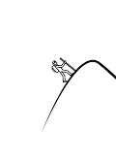
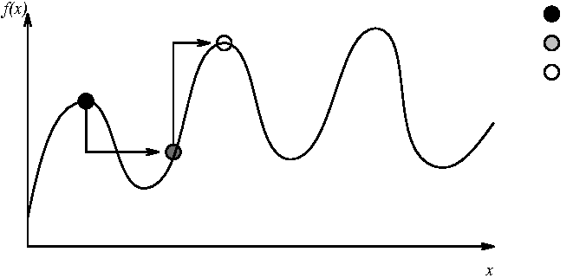

New Algorithm: Memetic Algorithms Overview
Hill Climbing $≈$
Moving in the Direction of the Gradient
Starting Point
Solution After Running Genetic Algorithm
Solution After Running Hill Climbing
Burke et al. 1996

Slide 24
New Algorithm: Algorithm Comparison
Relevant Pros and Cons
Genetic Algorithms and Hill Climbing Have Opposite Strengths and Weaknesses
 | Multi-Objective Genetic Algorithms | Multi-Objective Hill Climbing
Pros | Crossovers can make large jumps in model space | Can fine tune solutions because searches for the best “nearby” solutions
Cons | Can make jumps too large in the search space to converge to optima | Can get stuck in plateaus and in local minima/maxima because only searches “nearby”

Slide 25
New Algorithm: Implementation
Extended Framework to Allow for Multi-Objective Local Search Algorithms and Implemented MO Hill Climbing
Extended Framework to Allow Users to Combine Existing Algorithms
NEW
NEW
Multi-Objective Hill Climbing in Search-Based Model Design
Only previous work in the field* linearized objectives into one function and used single objective hill climbing
Multi-Objective Memetic (Hybrid) Algorithms in Search-Based Model Design
To my knowledge no work has been published on memetic algorithms
* A Local and Global Tour on MOMoT, Bill et al. 2017

Slide 26
New Algorithm: Approach
Proposed Memetic Algorithm
Exploration
Exploitation
Exploration
Exploitation
Genetic
Algorithm
Multi-Objective
Hill Climbing
Genetic
Algorithm
Multi-Objective
Hill Climbing

Slide 27
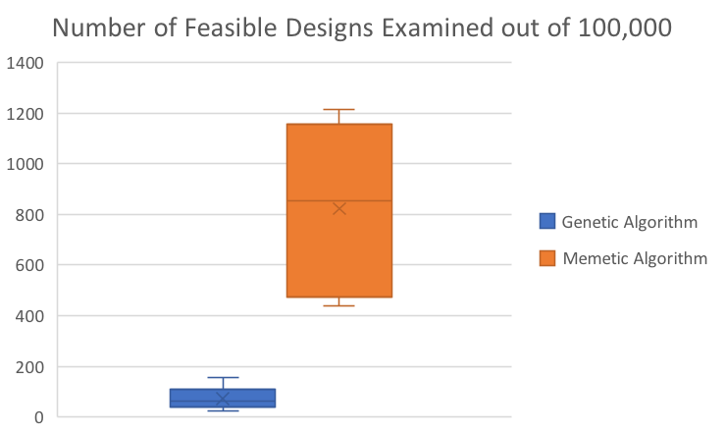
New Algorithm: Results
New Memetic Algorithm: Application to Cave Exploration Mission
On Average 751 More Fesaible Designs Examined with the memetic algorithm!

Slide 28
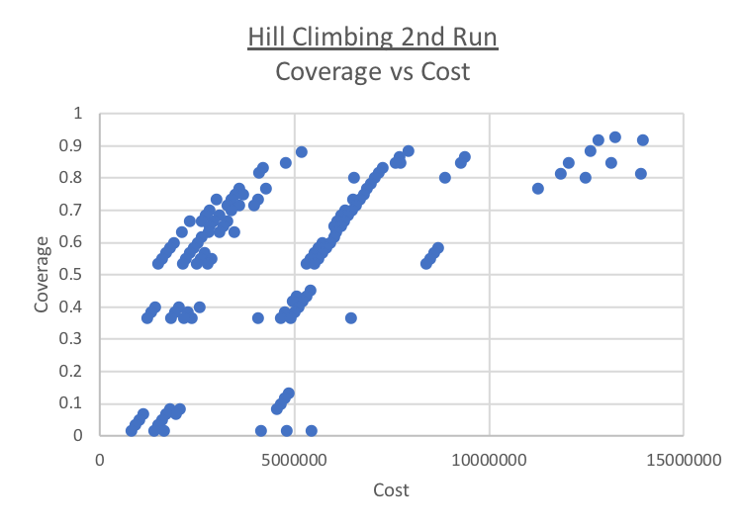
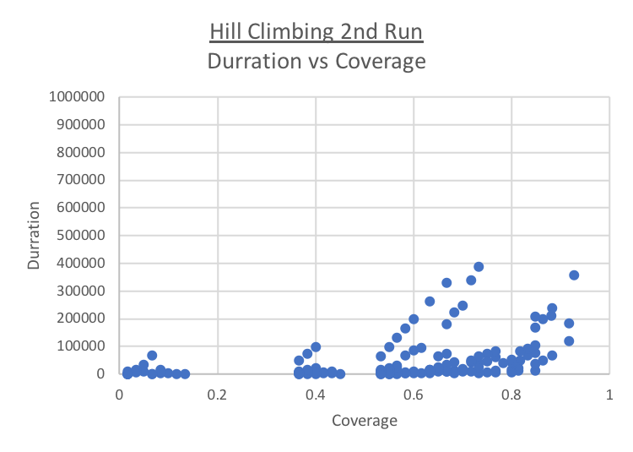
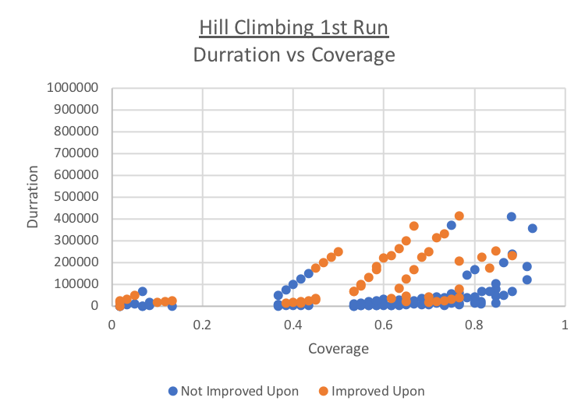
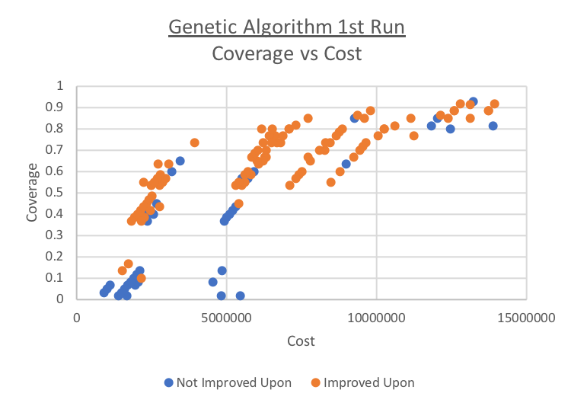
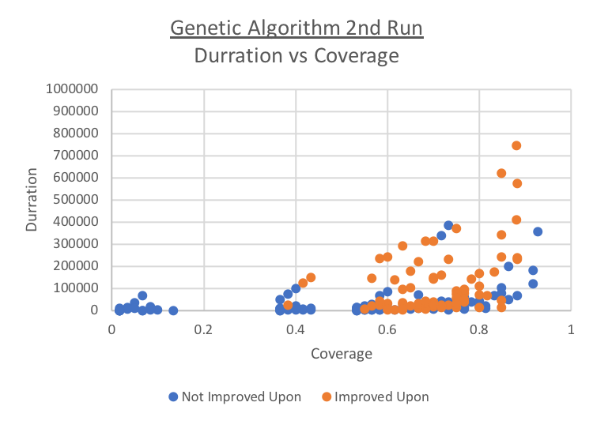
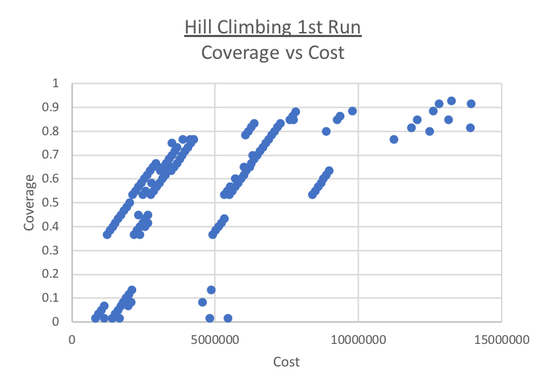
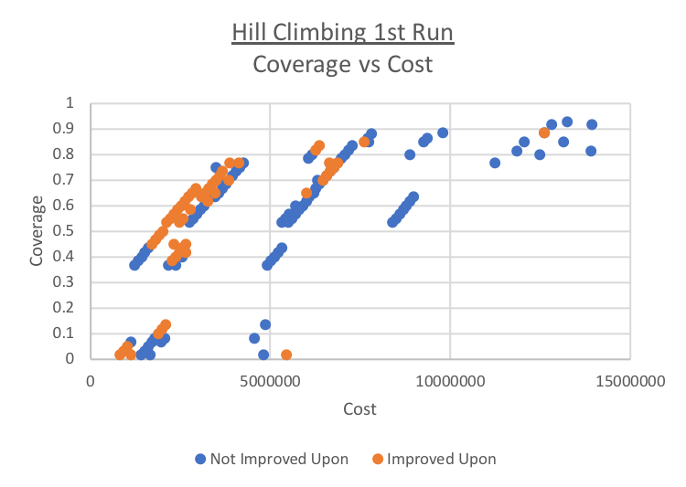
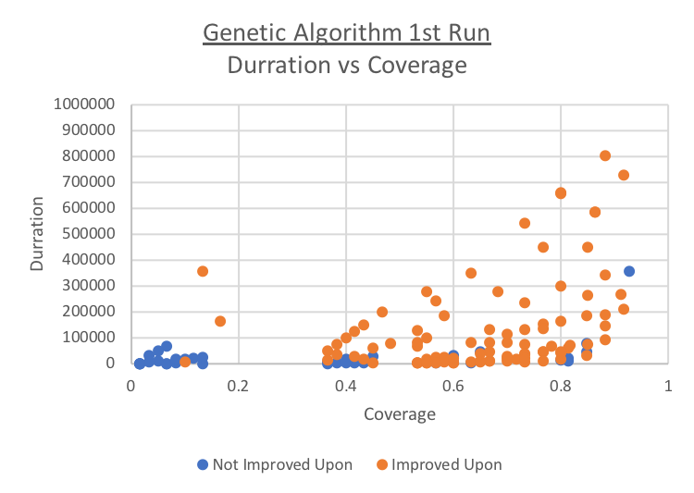
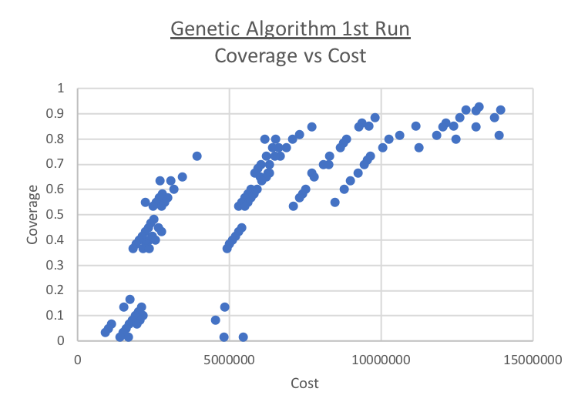
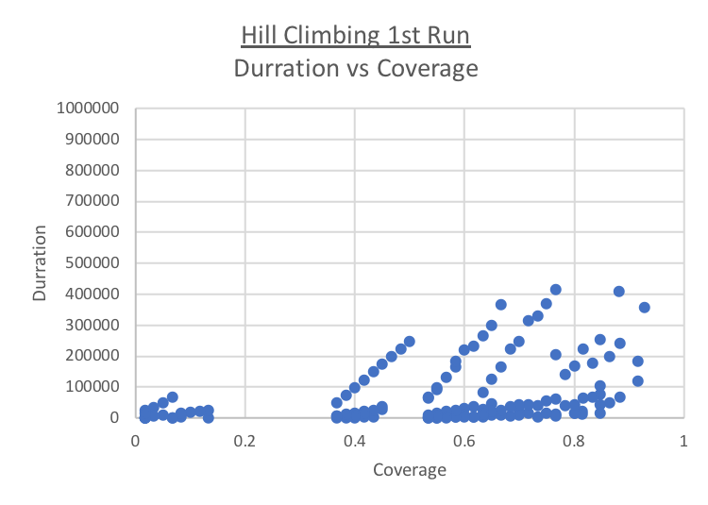
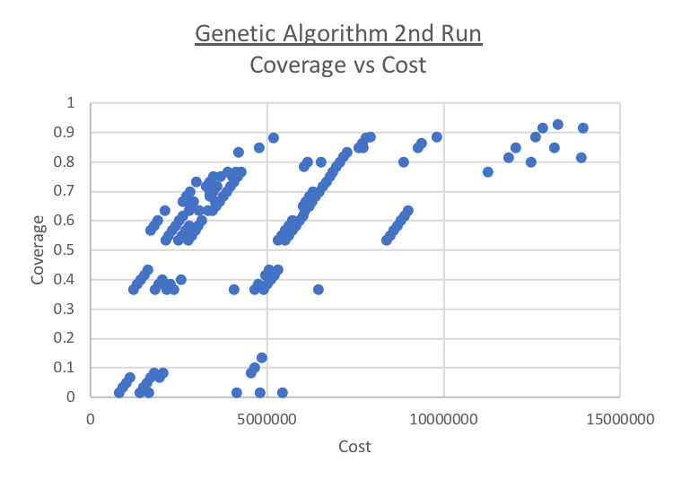
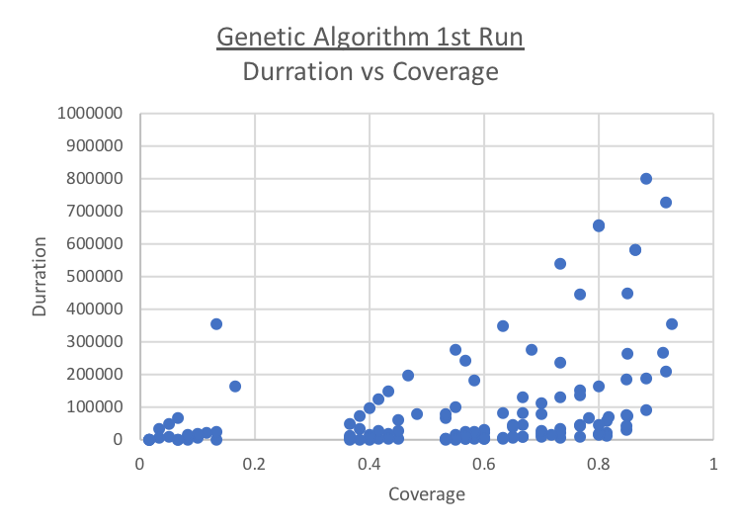
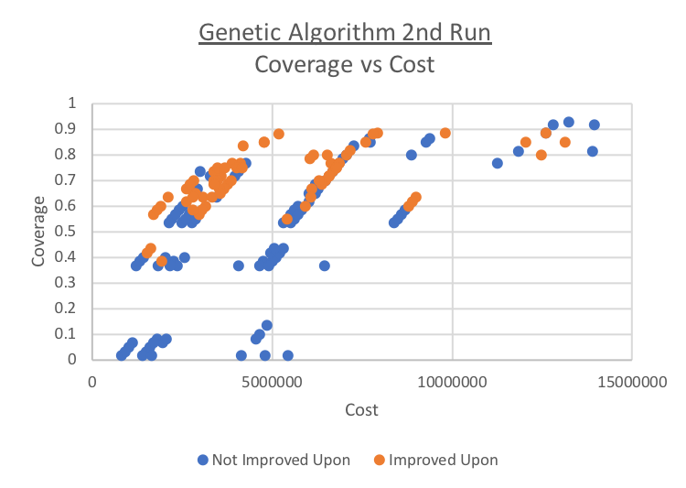
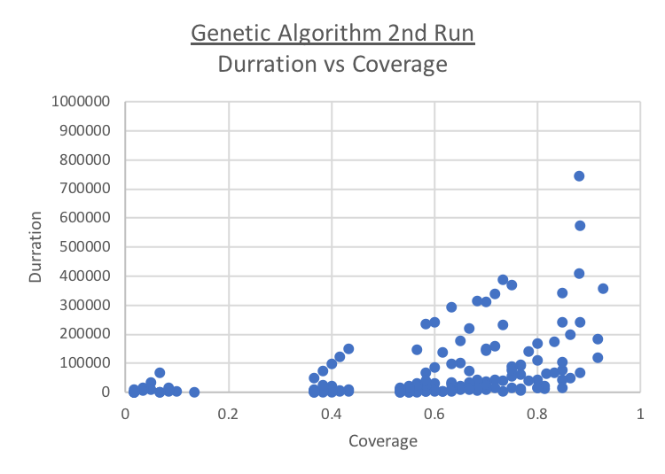
New Algorithm: Results
Proposed Memetic Algorithm: Application to Interferometry Mission
Genetic
Algorithm
Multi-Objective
Hill Climbing
Genetic
Algorithm
Multi-Objective
Hill Climbing

Slide 29
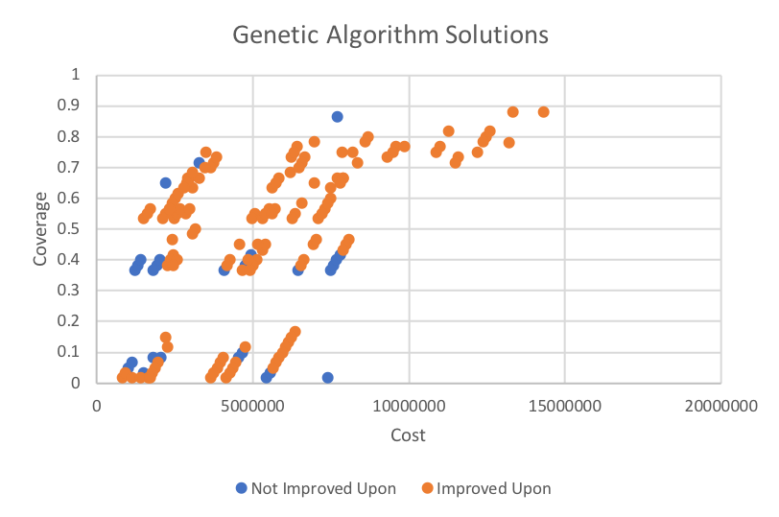
New Algorithm: Results
Genetic Algorithm vs Memetic Algorithm on the Interferometry Mission
Experiment Setup:
Ran a genetic algorithm (NSGA-II) and a Memetic Algorithm 5 times with a solution length of 150, population size of 1000 and 100 generations using the new rules then the solutions were compared
Of the Designs Found Using a Genetic Algorithm, 83% were Improved Upon by Designs Found Using a Memetic Algorithm!

Slide 30
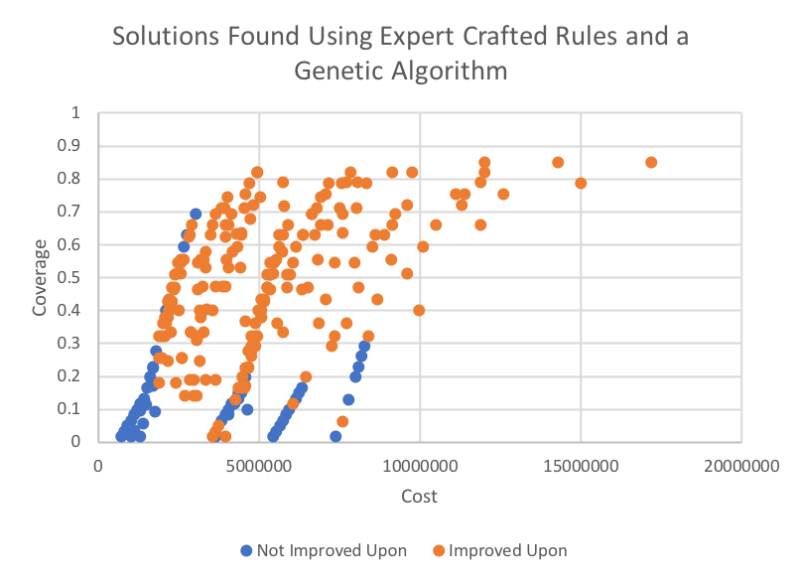
New Algorithm: Results
Expert Crafted Rules + Genetic Algorithm
vs Autonomously Generated Rules + Memetic Algorithm
Experiment Setup:
Ran a genetic algorithm 5 times with a solution length of 150, population size of 1000 and 100 generations using the new rules
Same population size and generations used to find the expert rule solutions
Of the Designs Found Using Expert Crafted Rules and a Genetic Algorithm, 79% were Improved Upon by Designs Found Using the New Rules and a Memetic Algorithm!

Slide 31
Conclusions
Will starting the search from a small, feasible model decrease the time needed to find a solution?
Yes, was able to find a feasible solution to the Mars Cave Exploration Case Study in on average 5,770 fewer iterations!
Caveat: may be more sensitive to restarts
Can autonomously generated rules outperform those created by domain experts?
Yes, with all else equal, 63% of the solutions found by expert crafted rules were Pareto dominated!
Can other algorithms search the model-space better than a genetic algorithm?
Yes, using a memetic algorithm 79% of the solutions found using a genetic algorithm and hand crafted rules were Pareto dominated and 83% of the solutions found using a genetic algorithm and the new rules. On average increased the number of feasible solutions evaluated on the Mars Cave Exploration Mission all else equal by over 1000%!

Slide 32
Future Work and Limitations
Limitations
It has been shown that autonomously generating a starting location and exploration rules can outperform those those created by a user. However, the results from the solver are only as good as the model that is input.
Future Work
Check if a user input design problem can have a feasible solution
Thought: convert the model representation to a boolean formula and use a satisfiability solver, such as Z3 (see: Sandeep Neema et al.)
Currently, exploration rules are chosen from the set of rules uniformly. Choosing rules according to other probability solutions should be explored
Thought: choose exploration rules according to a probability based on the height of the model element being added in the composition hierarchy

Slide 33
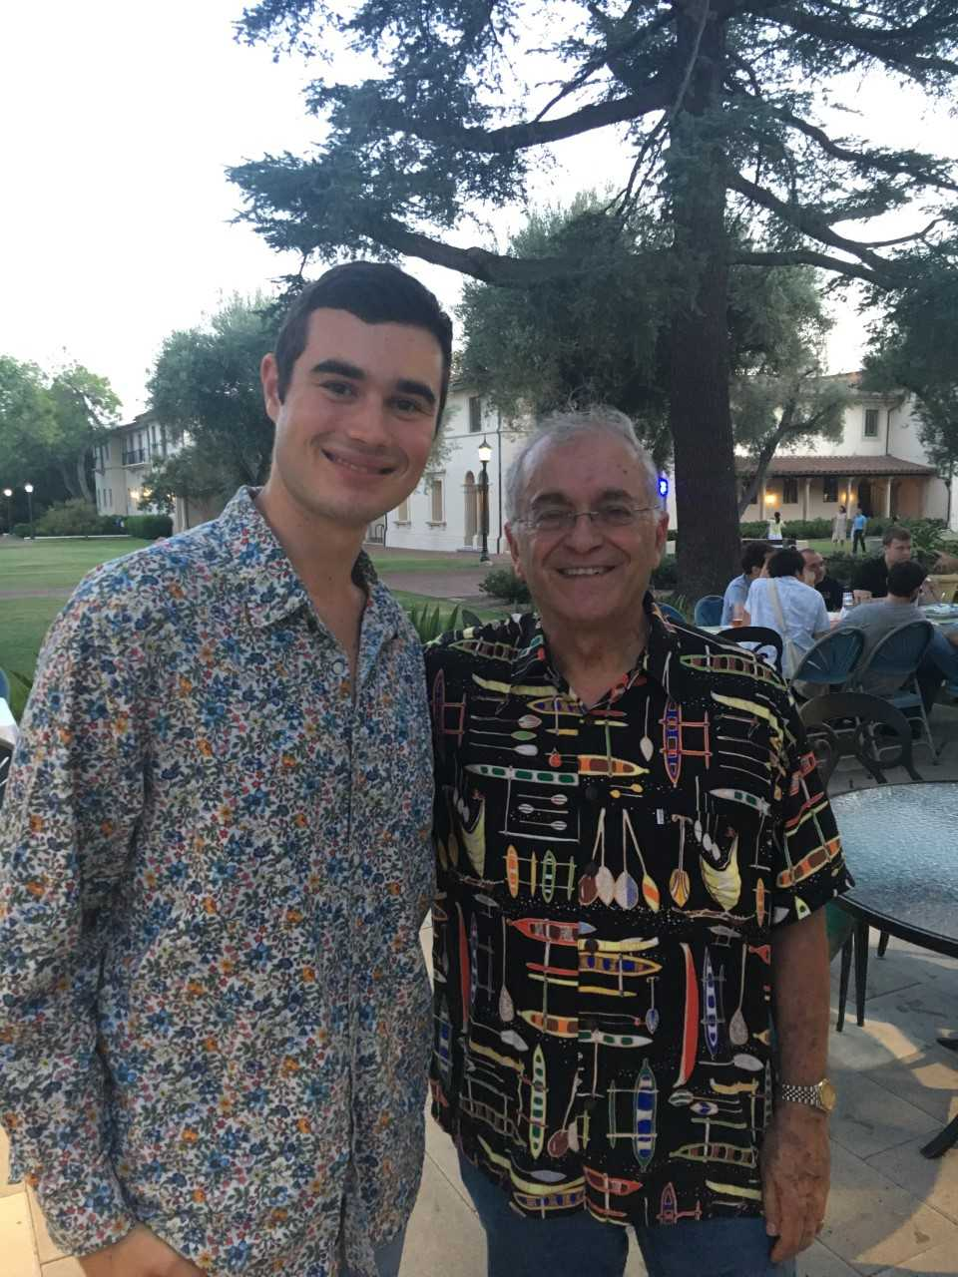


Thank You!
Special thanks to Dr. Sebastian Herzig for his help and guidance this summer and JPL’s Education Office for hosting me! I have had an amazing summer!

Slide 34
Acknowledgments
This research was carried out in part at the Jet Propulsion Laboratory, California Institute of Technology, under a contract with the National Aeronautics and Space Administration.

Slide 36
Backup Slides

Slide 37

Motivation
Multi-Spacecraft Mission Design: The Case for Computational Methods
Solar Panels: 6
Choosing
1 from each
Category
Choosing only 2 CubeSats
Cameras: 3
Antennas: 6
Possible CubeSats:
211,680
Possible Missions:
$$2.24 ∗{10}^{10}$$
CPUs: 2
Buses: 7
Launch Adapters: 7
Attitude Actuators: 10
Propulsion: 3
Notes:
5

Slide 38
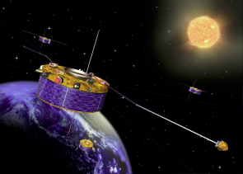

Motivation
Multi-Spacecraft Mission Design
Science Needs
Fault Tolerance
Credit: ESA
Credit: NASA
Notes:
5

Slide 39
New Algorithm: Why Use a Memetic Algorithm?
Fighting Conventional Wisdom
Claim:
Genetic Algorithms are not well suited to searching model space
Justification:
Crossovers can make big are likely not valid models
Success of a solution can not be attributed to the success of the substrings (for this same reason hill climbing algorithms generally outperform genetic algorithms on the Traveling Salesman Problem without specially tailored mutation and crossover operations)
Proposed Solution:
Once a feasible solution is found, search around the solution by making small changes (additions or subtractions) to the model
Conventional Wisdom
Genetic Algorithms perform better than Hill Climbing because the crossover operation helps get out of local minima
Genetic Algorithms can get stuck in local minima if the maintained population lacks diversity
Some algorithms maintain diversity by favoring solutions with diverse objective values
Work done by a previous intern showed that models with similar objective values can be very different

